Slide 1

Knitting Machine monitoring system

Slide 2
Supervisor
LOCHANA RANATUNGA| Senior Executive - Engneering
MAS FABRICS (PRIVATE) LIMITED - INTIMO DIVISION
Project Owner
Supun Chirantha
Electronic and Telecommunication Department
University of Moratuwa
6-Munth Internship Project

Slide 3
Introduction
This is the System to replace the existing knitting machine breakdown recode system for MAS Fabric Intimo
This system has following features
Real time data monitoring
Real Time data recoding
Real time data analyse
Real Time alert notification

Slide 4
background
Why
There are inefficiently and data loses will existing the manual system
Nautilus system - Lack of support from the nautilus system tourd engineering breakdown data
No existing utility data capturing method in knitting machine

Slide 5
Objectives
Live dashboard where you can check the machine running condition
To instantly detect machine conditions and immediately trigger sound alarms to alert engineers.
To provide periodic historical reports of machine condition.
The manual breakdown report system is to be automated and viewed.

Slide 6
Method
Real time machine condition
Compress air pressure
Power consumption
Luwa pressure
Machine RPM
Engineering Breakdown chart
Real Time Dashboard
Breakdown Report Mobile App
Database
Knitting Machine
Module

Slide 7
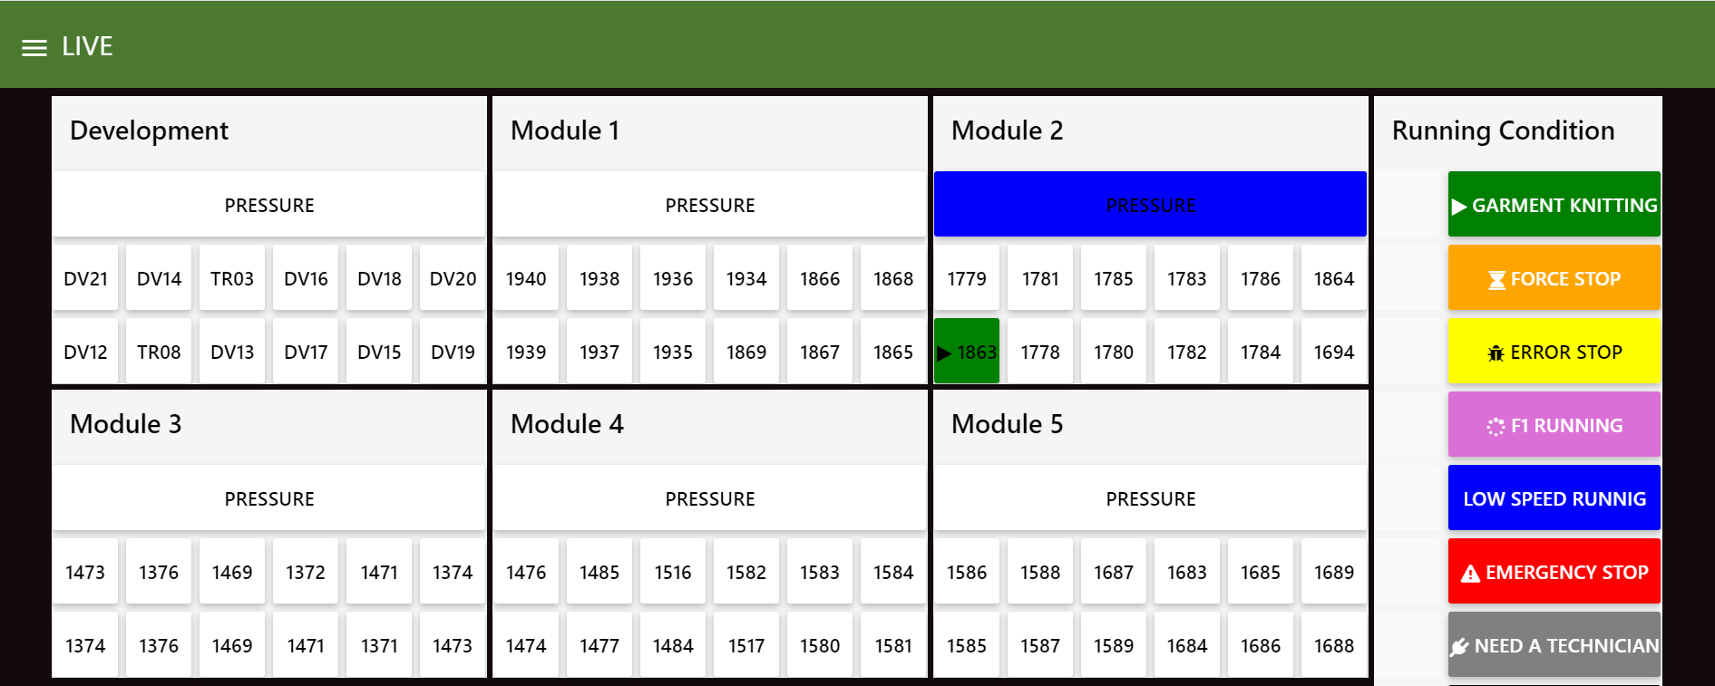
Real Time Dashboard
Real time machine condition
Compress air pressure

Slide 8
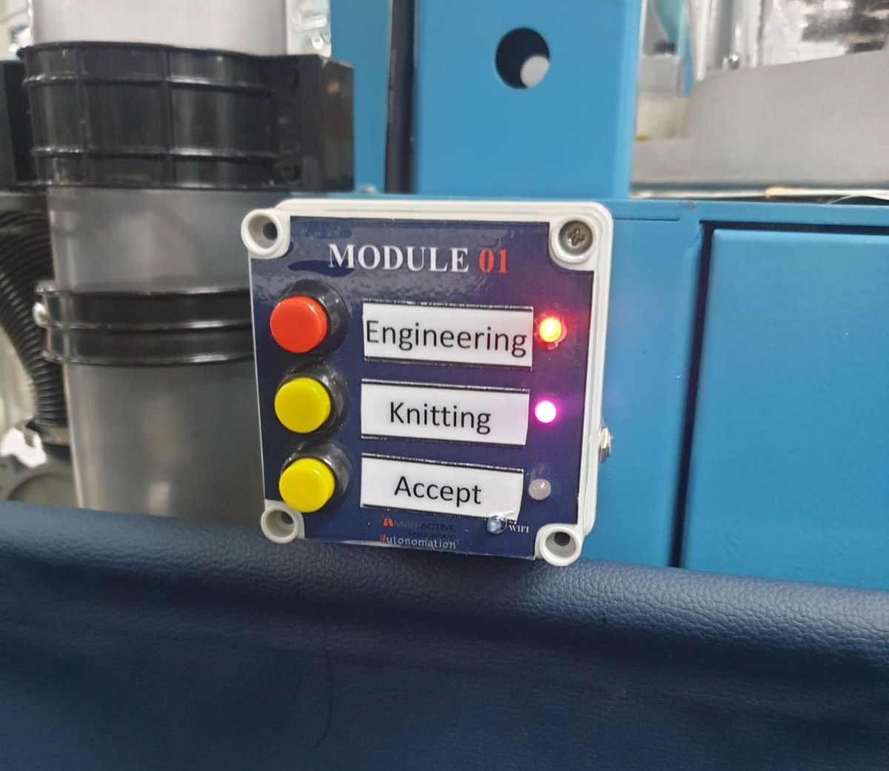
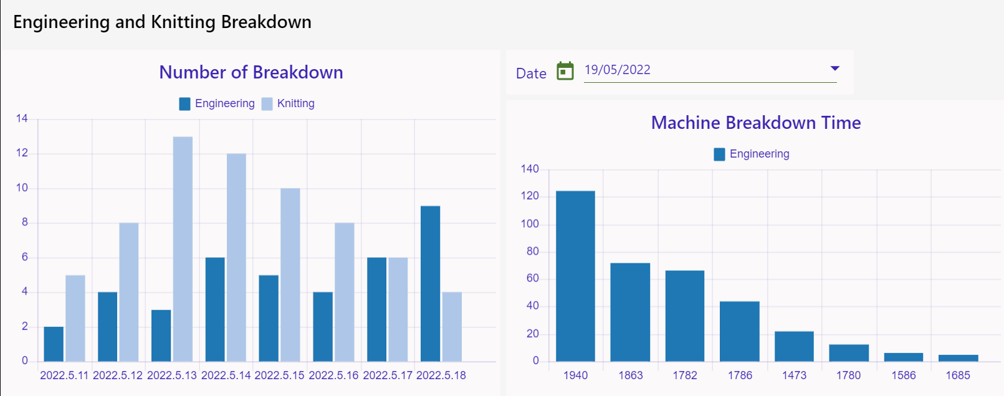
Engineering and knitting Breakdown chart
Time(min)
Number of Breakdown
Date
Machine No

Slide 9
Method
Real time machine condition
Compress air pressure
Power consumption
Luwa pressure
Machine RPM
Engineering Breakdown chart
Real Time Dashboard
Breakdown Report Mobile App
Database
Notification to the technician
Collect Breakdown Report
Real time machine Breakdown condition
Knitting Machine
Module

Slide 10
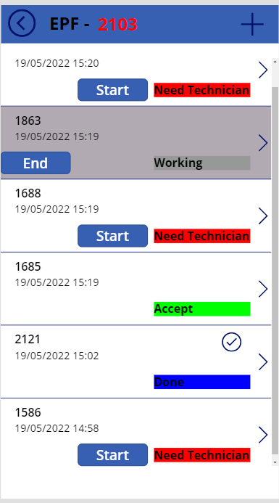
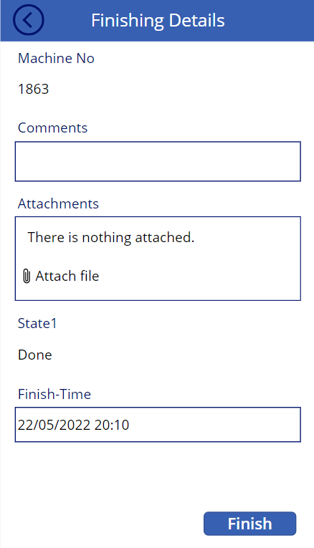
Breakdown Report Mobile App
Mobile app live dashboard

Slide 11
Method
Real time machine condition
Compress air pressure
Power consumption
Luwa pressure
Machine RPM
Engineering Breakdown chart
Real Time Dashboard
Breakdown Report Mobile App
Database
Notification to the technician
Collect Breakdown Report
Real time machine Breakdown condition
Knitting Machine
Module
Engineering and knitting Breakdown Chart
Breakdown Report

Slide 12
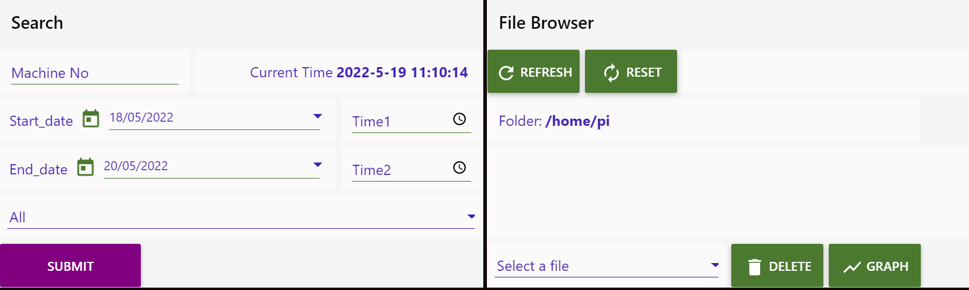
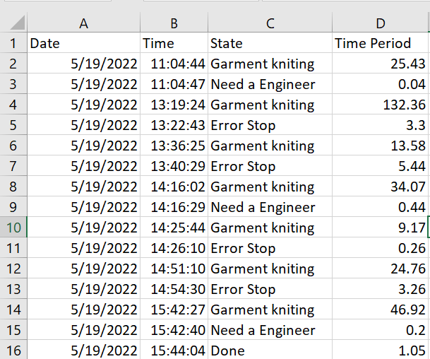
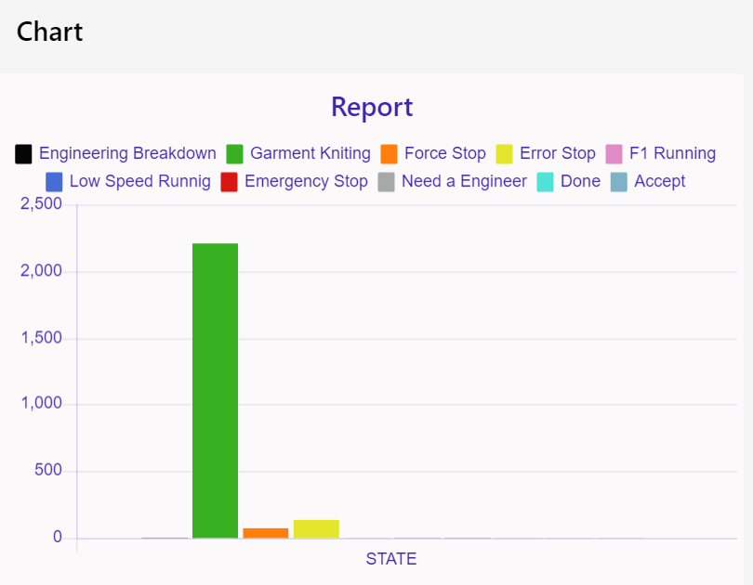
Database
Time(min)

Slide 13
Financial information for 12 knitting machine
Total Cost = $ 172
Financial information for 216 knitting machine
Total Cost =$ 3089
Cost per Item =$ 14.3/=

Slide 14
Return on investment
This project only as qualitative return.
This could use to improve the TPM of the knitting machine.
This data could use to improve the machine maintenance efficiency and effectiveness.
Engineering team to forecast future machine breakdown trends
This data is useful to introduce proper and effective planed maintenance strategy
Operator team could use to track their machine utilization

Slide 15
Data usage per Month
Storage usage per Month
Transmit String =”11000,10001”
Include Bit =99 B+100B
Transmitted per hour =240
No. machine =216
Data usage per hour =199*240*216B
=1259.12Kb
=1.22Mb (rough calculation)
Data usage per Month =878.4Mb
Storage usage per day =15KB*216
Storage usage per Month =95MB

Slide 16
Manual Vs this
No data loses
Data accuracy
Easy asses
Easily Analysis
Time Saving
Every result tracking
Data Transparency

Slide 17
Nautilus Vs This
Could have a results on engineering Breakdwon
Could recent garment relevant B/D
By B/D data specipy and easily understand
Utility Tracking
Notify by tech
Easier knitting machine operator to call for help

Slide 18
Network Cost
Plant IOT network system - No extra cost needed
Assemble the separate Network system - $ 3010
Cable - $ 520
Switch - $ 1440
Router - $ 1050

Slide 19
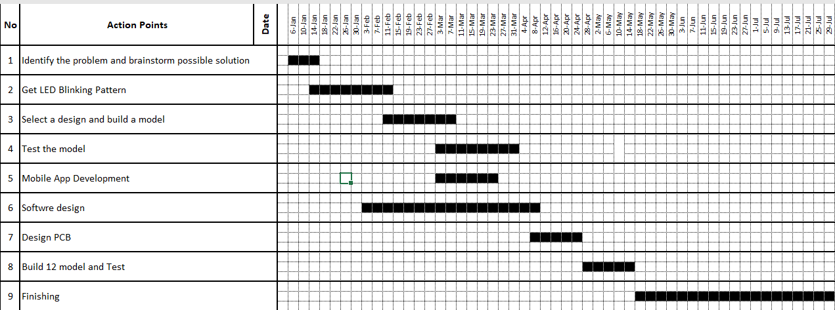
Knitting machine Monitoring system action plan

